Slide 1
AI in Medical Technology
By Aaryan Samanta

Slide 2

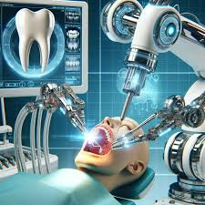
AI is replacing Human Doctors
-The next time you go to the dentist to get your teeth checked would you want to see a friendly doctor happy to check for cavities, or have a menacingly looking machine, that looks like it might kill you.
-The machine may not be all that bad. Artificial intelligence (AI) has many features that could put them above doctors, in addition to being smarter than them.
-However, there are some key things that AI lacks, which could potentially be dangerous.

Slide 3

Positives of AI replacing human doctors
-AI can make correct diagnoses in 97% of patients, compared to 87% for human doctors. It can also perform comparably to or exceed cardiologist clinical diagnoses, and outperform primary care physicians when assessing the severity of Parkinson's disease.
-AI can analyze a patient's genetic makeup, medical history, and real-time health data to generate individualized treatment plans. This could lead to more effective therapies, fewer side effects, and better patient outcomes.
-On top of everything, AI is also much cheaper than doctors, benefitting hospitals in rural areas or underdeveloped countries.
-With all these positives, AI seems perfect right?

Slide 4

Negatives of AI replacing human doctors
-There are also reasons why some say that AI shouldn't replace doctors
-AI lacks the human qualities that help doctors build trust with patients, such as empathy, compassion, and emotional intelligence, leading many to question whether it’s morally correct for AI to replace doctors completely.
-Patients want to know their doctor understands their perspective and has the knowledge and training to help them.
-Computers can't use the intuitive reasoning that doctors use to evaluate information from multiple sources to make a diagnosis and create a treatment plan.

Slide 5
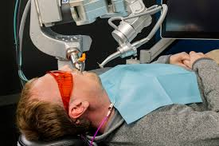
Examples of AI being used in Medical Field
-Very recently, a procedure involving AI for a dental surgery was completed
-This dental robot, made by Boston-based company Perceptive, is guided by AI with 3D imaging software and operates a robotic arm to perform dental tasks.
-The system can complete restorative dental work, like crown replacements, in just 15 minutes, which is much faster than any human can possibly do
-The surgery was completed successfully with no errors at all

Slide 6

My opinion
-AI should be instituted in the medical industry, but shouldn’t replace doctors completely
-AI machines should have doctors close by watching, ready to stop the machine if anything goes wrong
-Doctors should still do some procedures that AI is unable to do
-Patients should have the right to choose whether they want an AI to treat them, or a doctor to treat them

Slide 7
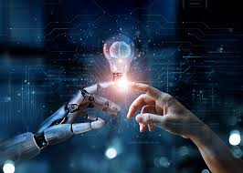
Conclusion
-AI can never completely replace humans, no matter what it is.
-We still shouldn’t ignore the existence of AI, but instead take advantage of its many uses, especially in the medical field
-When playing all the right cards, AI can be seen as an opportunity to grow and develop, rather than something to be feared and resented

Slide 8
Works Cited
https://insight.kellogg.northwestern.edu/article/will-ai-replace-doctors
https://www.ncbi.nlm.nih.gov/pmc/articles/PMC10328041/
https://www.indiatoday.in/health/story/in-worlds-first-ai-robot-performs-complete-dental-procedure-boston-man-2579007-2024-08-08
https://www.independent.co.uk/news/world/americas/robot-dental-surgery-ai-perceptive-b2591701.html

